Slide 1
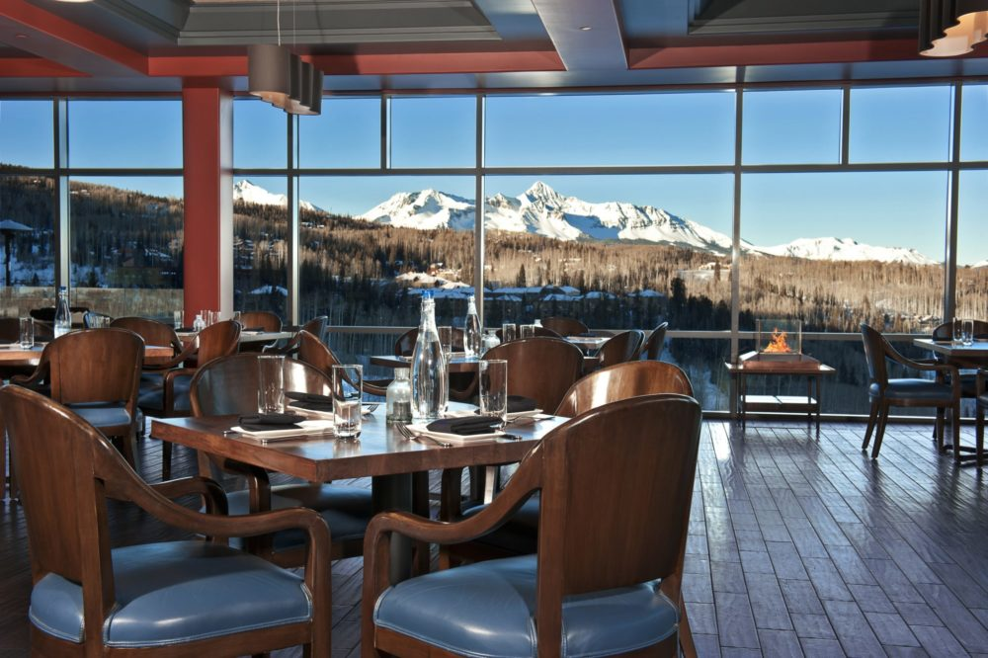
THE FOODIES
Marie Bourne, Hanna Huseva, Habib Khan, Nenye

Slide 2
SCOPE OF WORK
The Foodies App is designed to help users narrow down restaurants and food options based on location and budget.
The user is asked to enter or choose from the following variables:
City and State (only in USA)
How far they are willing to travel
Type of cuisine they are hungry for?
How broke are they?

Slide 3
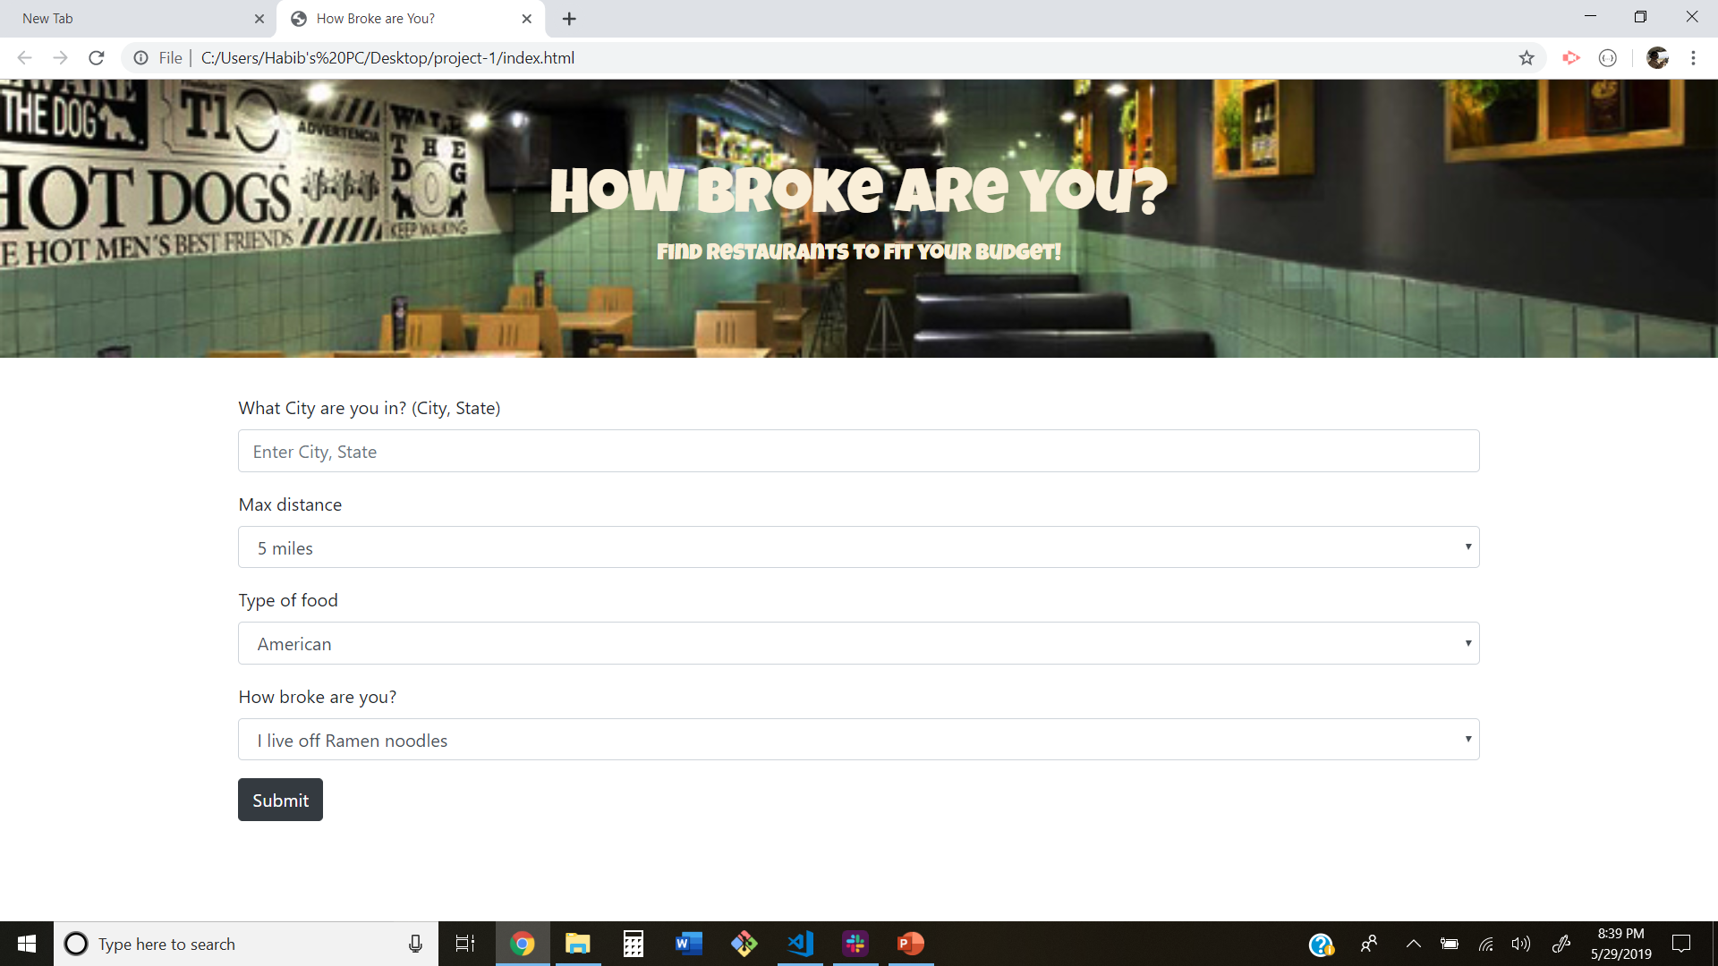

Slide 4
RESULTS PAGE
The results page displays ten restaurants which meet the users criteria.
The user’s choices from the search form are displayed before the search results.
The results cards include:
Name of restaurant
Restaurant Address
A link back to the restaurant’s Zomato page
Along with the restaurant results, (10) random gifs of the type of cuisine chosen will appear along the side

Slide 5
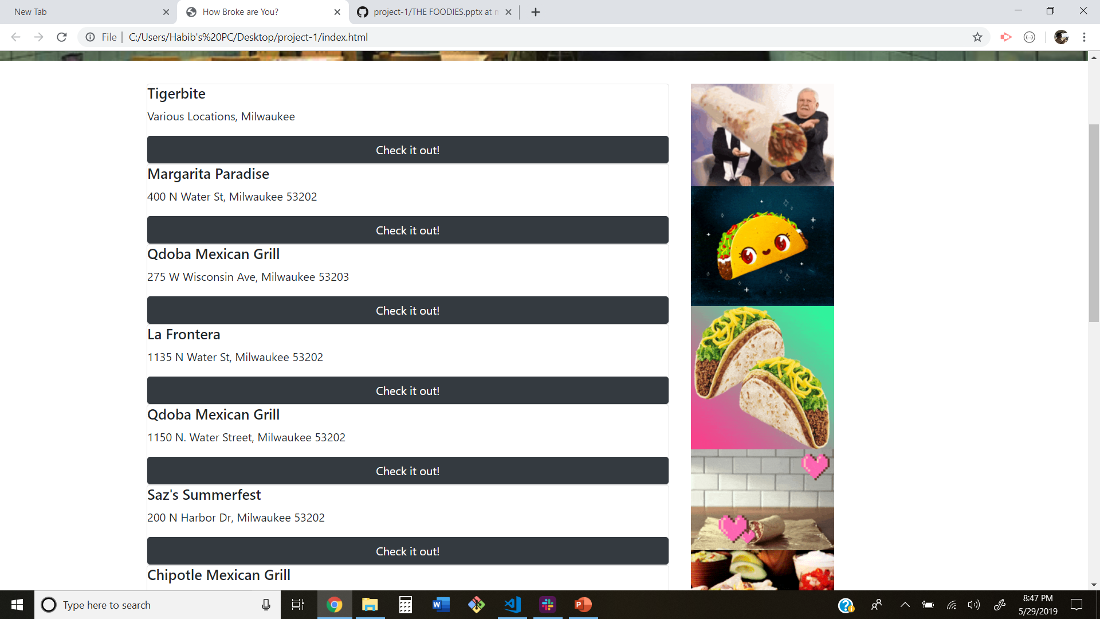

Slide 6
OUR MODIVATION?
WE.
WERE.
HUNGRY.

Slide 7
DESIGN PROCESS
Initially we had to decide what type of app we were going to build.
Once the app concept was finalized, we moved to create a wireframe of both the search and results pages.
We then decided on which parameters to use. In order to achieve our MVP, we wanted to minimize user input as much as possible.
We chose to let the user pick from predetermined options rather then enter custom data.

Slide 8
DESIGN PROCESS
We had to choose which API we were going to use. Yelp’s API does not allow retrieval of data using jQuery, therefore we had to use Zomato for our jQuery.ajax pulls.
We had to make sure the parameters we were using in our search form were responses in the Zomato API requests.
Since Zomato uses city ids instead of city names, it took multiple queries. First we had to find the location id and then pass it into the restaurant search id. Very Complicated!
We used Giphy to display funny gif’s on the results screen. We used the cuisine type user input from the search form for this request.

Slide 9


TECHNOLOGIES USED

Slide 10
FUTURE DEVELOPMENT
We would like to display an image of the most popular dish from each restaurant in the seach result.
Use the users current location rather than entering a city and state.
Use Firebase to store the user searches. Then give the user suggestions based on their search history database for recommendations.
Provide the user with recipes for desired food based on their cuisine type choice.

